Slide 1
Nonparametric density estimation and classification
General considerations
Kernel density estimation
K-nearest neighbor

Slide 2


Density estimation
Classification can be based on estimating the density for each of the classes. From a set of observed random vectors,
{x₁, x₂, ……, x_{n}} → p(x)
The probability that a vector x, drawn from p(x) falls into region R of the sample space is
When N data points are observed from the distribution, the probability that exactly k of them fall into region R is

Slide 3


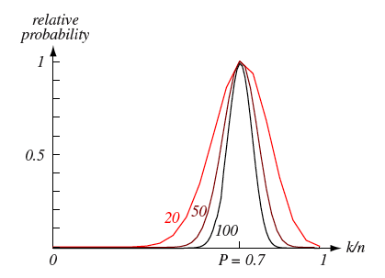
Density estimation
According to the properties of the Binomial distribution,
As N increases, the variance diminishes. k/N becomes a good estimator of P.

Slide 4



Density estimation
When big enough sample is available, we can use small R such that p(x) varies very little within R. Let V be the volume.
Since we also have
Then,
As N increases and V decreases, the estiamte becomes more accurate.

Slide 5
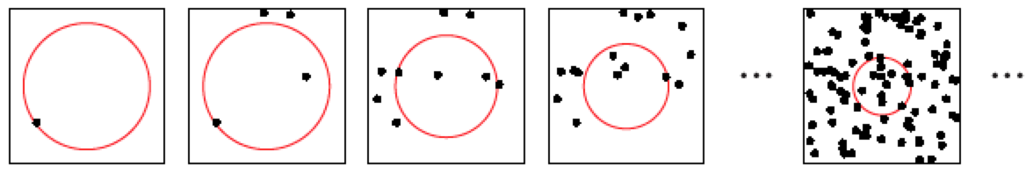




Density estimation
Asymptotic considerations.
Construct R₁, R₂, R₃, ……with a growing number of samples.
Let V_{n} be the volumes, k_{n} be the number of samples included, and p_{n}(x) be the n^{th} estimate of p(x)
Three conditions are to be met for p_{n}(x) to converge to p(x)
the space averaged P/V will converge to p(x)
k/n will converge to the probability P
p(x)=k/nV is to converge

Slide 6


Density estimation
How to obtain such a sequence R₁, R₂, R₃,……
Two general approaches:
Specify V_{n} to be a function of n, for example
Show that k_{n} and k_{n}/n conform to the three conditions.
* This is the kernel density estimation
(2) Specify k_{n} as a function of n, for example
Use V_{n} such that k_{n} samples are contained in the neighborhood.
Show that V_{n} conform to the conditions.
* This is the k_{n} nearest neighbor method.

Slide 7
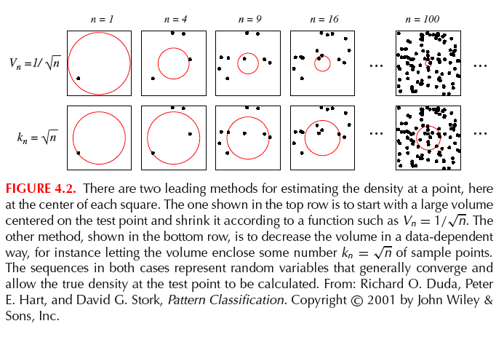
Density estimation

Slide 8
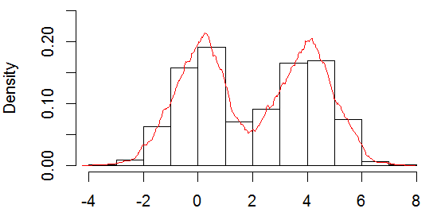
Histogram
The histogram is close to, but not truly density estimation.
It doesn’t try to estimate p(x) at every x. Rather, it partitions the sample space into bins, and only approximate the density at the center of each bin. It is a sample collected from the kernel density estimation where the kernel is a box.

Slide 9

Histogram
For bin b_{j}, the histogram density of the i^{th} classis defined as
Within each bin, the density is assumed to be constant.
It is a legitimate density function --- positive and integrate to one.

Slide 10
Histogram
The histogram density estimation is influenced by:
The starting position of the bins
The orientation of the bins in >1 dimension
Artifact of discontinuity
Since the bins are equal size, when dimension is high, a huge number of bins are needed, and most are empty with limited amount of data.

Slide 11


Kernel density estimation
Emanuel Parzen 1962.
The original version is rectangular (box) kernel.
Some use “Parzen window” to refer to kernel density estimation.
Define a window function
This is a unit hypercube centered at origin.
Given the volume of a d-dimensional hypercube V_{n}, the edge length h_{n} satisfies

Slide 12


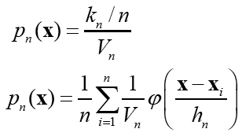
Kernel density estimation
By h_{n}, we can define the kernel:
If x_{i} falls within the hypercube centered at x, with volume V_{n}
The number of samples in the hypercube is:
The estimate of p(x) is
This is the summation over all points’ “contribution” at the location.

Slide 13

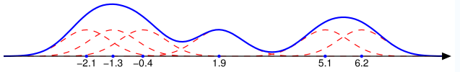
Kernel density estimation
Is the p_{n}(x) a legitimate density function? It needs to satisfy (1) nonnegative and (2) integrate to one.
This can be achieved by requiring the window function to satisfy these conditions:
The window function can be generalized – no longer just a box.
Notice any density function satisfies the above requirement:
p_{n}(x) is a superposition of n density functions.

Slide 14
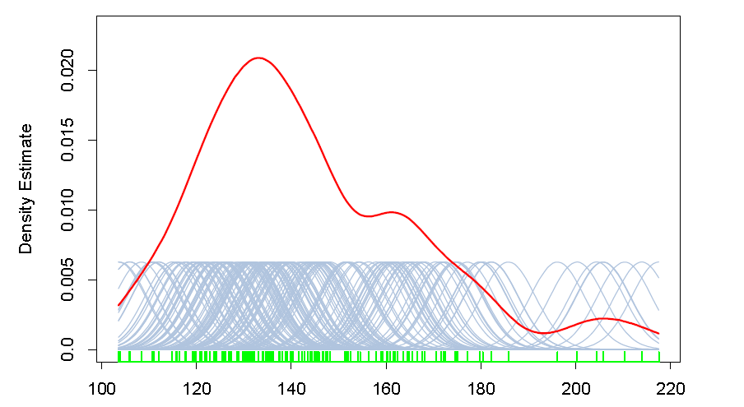
Kernel density estimation

Slide 15
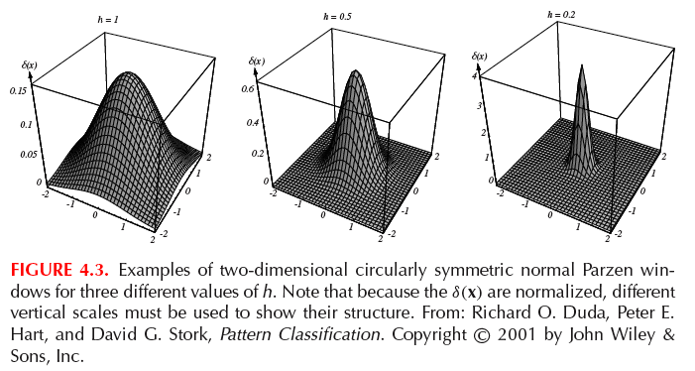
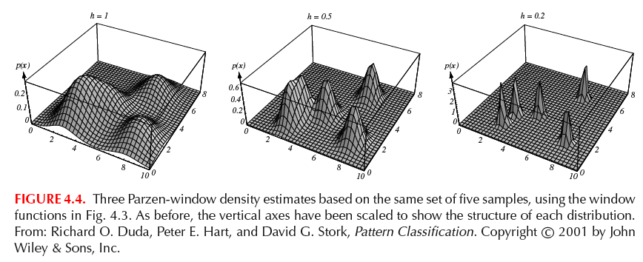
Kernel density estimation

Slide 16
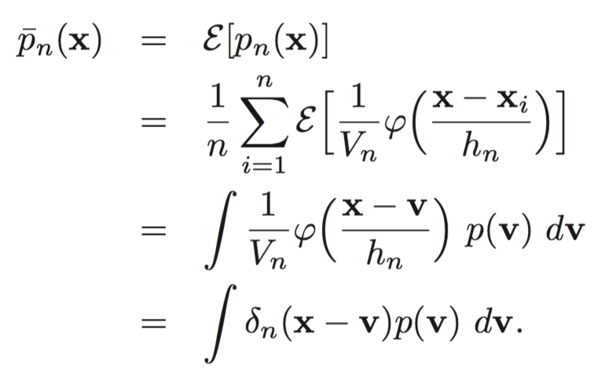
Kernel density estimation
We want the mean of p_{n}(x) to converge to the truth p(x)
The expected value of the estimate is an average of the true density around x. It is the convolution of the true density and the window function --- a “blurred” version of the truth.
When

Slide 17
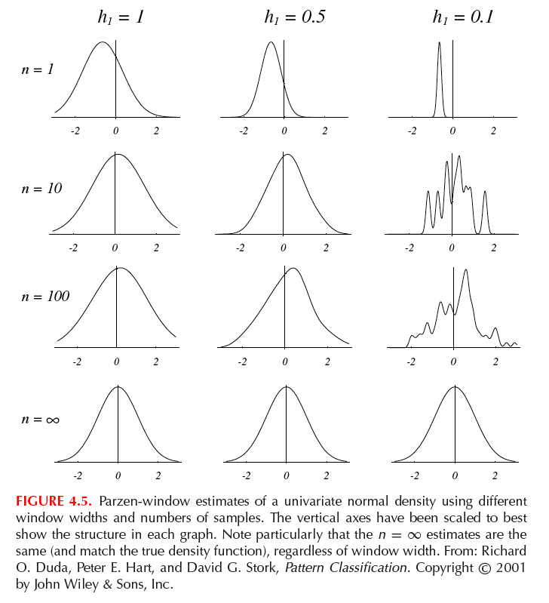
Kernel density estimation
p(x)
Standard normal.

Slide 18
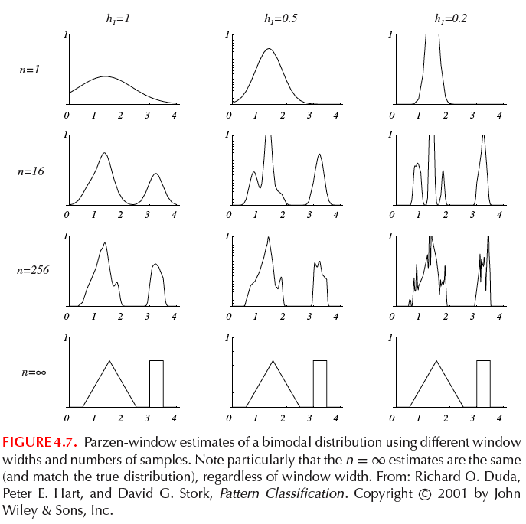
Kernel density estimation

Slide 19
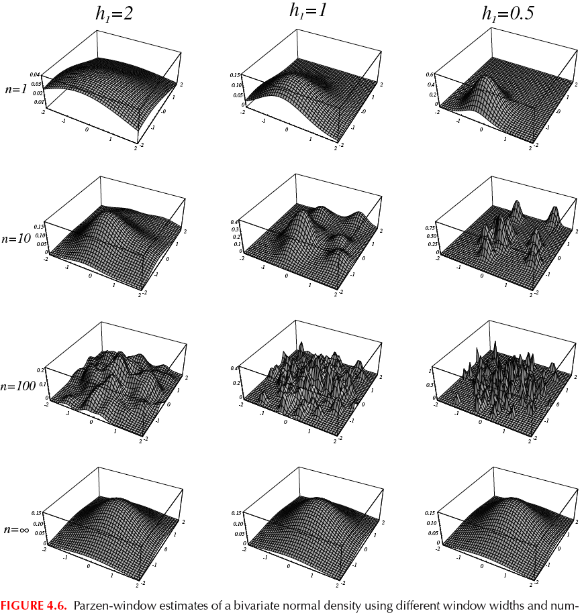
Kernel density estimation

Slide 20
Classification using kernel density estimation? (bad idea)
Estimate the densities for each class
Construct a Bayes classifier using the densities. Classify a test object based on the posterior probabilities and the loss function.
The decision boundary of the classifier depends upon the choice of window function and window size.

Slide 21
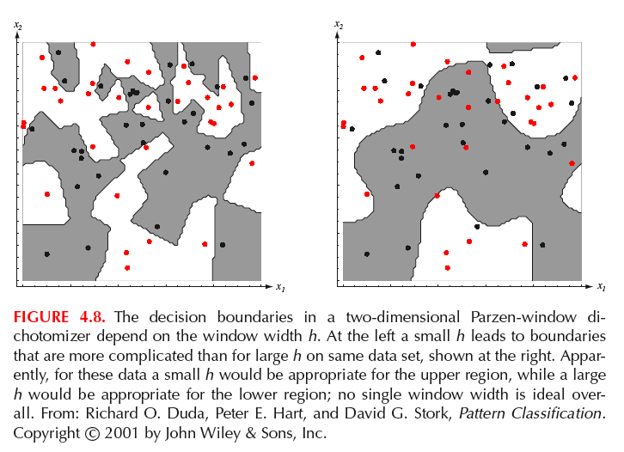
Classification using kernel density estimation? (bad idea)

Slide 22

KNN density estimation? (another bad idea)
To estimate p(x), we grow a cell from x until k_{n} samples are captured. k_{n} is a function of n.
The sample is the k_{n} nearest neighbors of x.
The density estimate is as discussed:

Slide 23
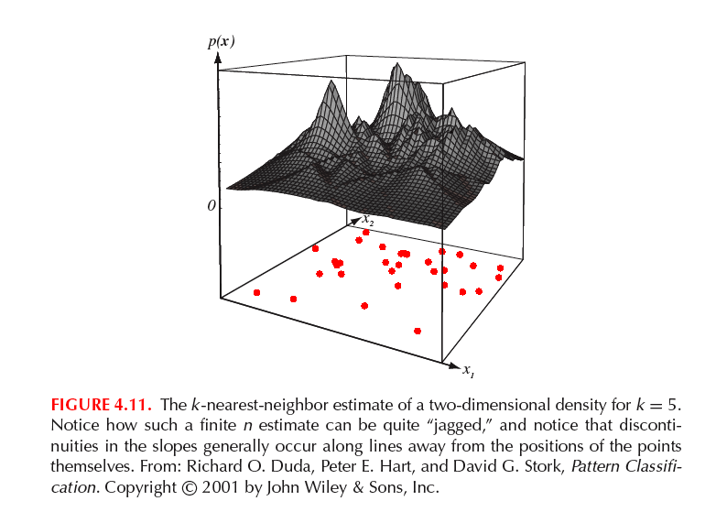
KNN density estimation? (another bad idea)

Slide 24
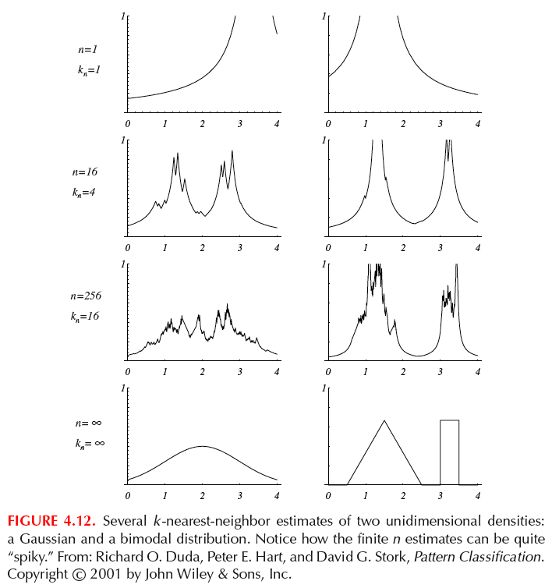
KNN density estimation? (another bad idea)

Slide 25



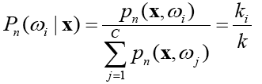
KNN classifier
Although KNN is similar to the kernel density, in terms of classification, it is used in a simpler way: directly estimate the posterior probability from n labeled samples.
A cell with volume V captures k samples,
K₁ in class 1; k₂ in class 2 …
The joint probability is estimated by
Then,

Slide 26
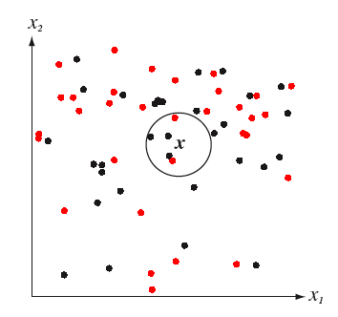
KNN classifier
The estimate of the posterior probability is simply the fraction of the samples within the cell belonging to a specific class.
Bayes decision is used again to minimize error rate.
Notice there is no computation to be done for the model-learning step. When a testing data is present, frequencies from training data around the testing data is used for classification.

Slide 27
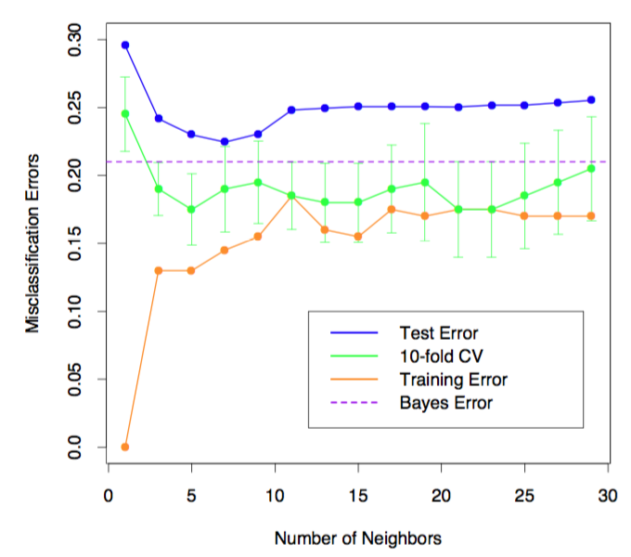
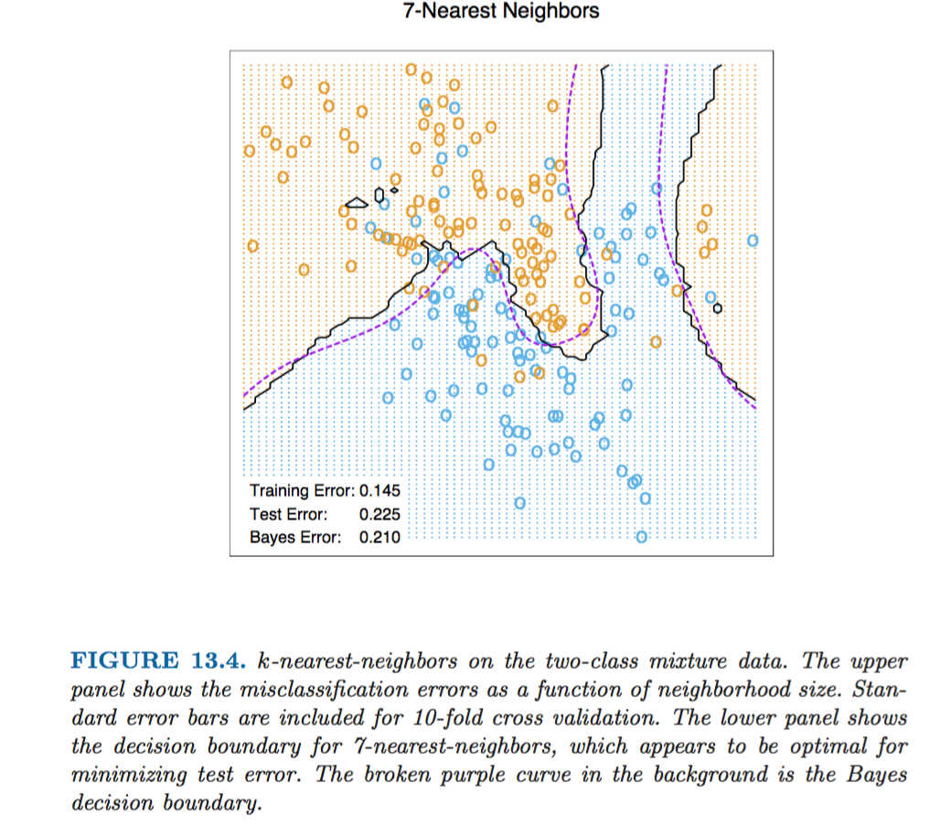
KNN classifier

Slide 28
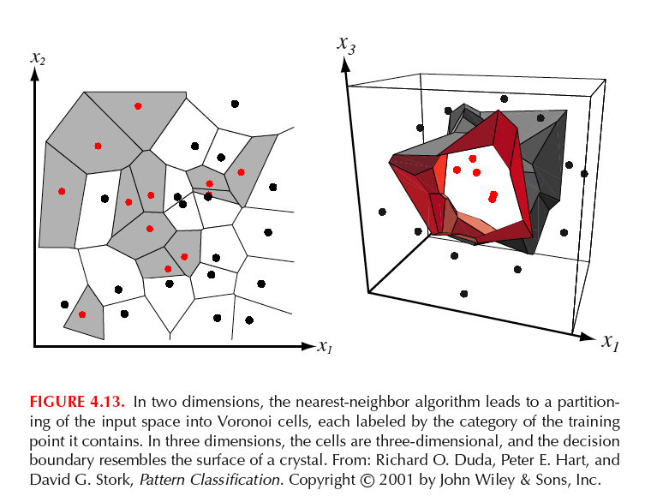
KNN classifier
Nonetheless, the rule is capable of drawing class boundaries.
The feature space is partitioned into “Coronoi tessellation”

Slide 29

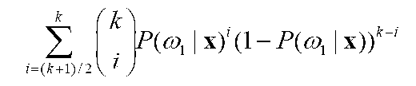
KNN error
KNN doesn’t reach Bayes error rate. Here’s why:
The true posterior probabilities are known.
The Bayes decision rule will choose class 1. But will KNN always do that? No. KNN is influenced by sampling variations. It chooses class 1 with probability:
The larger the k, the smaller the error.

